Slide 1
FRBR and Deduplication of Bibliographic Records in Primo VE NDE
Yoel Kortick
Yoel.Kortick@clarivate.com

Slide 2
  Introduction
  Example one: a bibliographic record to be FRBRized
  Example two: a bibliographic record to be FRBRized
  Example three: a bibliographic record to be deduped
  The Mapping of the Dedup Key Fields
  The Mapping of the FRBR Key Fields
  Why was example one FRBRized
  Why was example two FRBRized
  Why was example three deduped
  Disabling the Dedup and FRBRization entirely
  Disabling the Dedup and FRBRization for specific records
  Other configurations for Dedup and FRBR
Agenda

Slide 3
Introduction

Slide 4
Introduction
There are two processes used by Primo VE to combine or group redundant records in the brief results
  The Dedup (deduplication)
  FRBR (Functional Requirements for Bibliographic Records)
The Dedup and FRBR processes can be best understood by looking at a few real-life examples. That, among other activities, is what we will do here.
We will see, together live, why particular actual records are FRBRized and deduped.
We will also, together, live, “turn off” the FRBR and Dedup for the entire Primo View and also for specific records.

Slide 5
Introduction
The Dedup and FRBR processes reduce clutter by grouping related records.
Traditional cataloging could treat redundant records as separate, unrelated records, making discovery more difficult for users.
By establishing clear relationships among the records and grouping them together by deduplication or FRBR, the user experience in Discovery is greatly improved.
See also Dedup and FRBR for Primo VE

Slide 6
Introduction
Duplication Detection (Dedup)
  The duplication detection or matching process is based on creating a dedup vector for every Alma record.
  The vector includes all the data required by the Duplication Detection algorithm to determine if two records are equivalent.
  The vectors include one or more keys that identify the record. Keys are based on the metadata fields in the source record (MARC or DC records).
  In the search results, records that are marked as duplicates are displayed as a single record.
  The metadata is displayed from the first record in the results set, and the delivery related information is created from all the records in the group.

Slide 7
Introduction
FRBR
  Primo VE records are grouped using the principles in the Functional Requirements for Bibliographic Records published by the IFLA Study Group on the Functional Requirements for Bibliographic Records.
  The grouping process creates a vector for every Alma record.
  This vector includes one or more keys that identify the group it represents. Keys are based on the metadata fields in the source record (MARC or DC records).

Slide 8
Introduction
FRBR
  Records that have a matching key (Primo VE attempts to match all keys in the record) are added to a FRBR group and assigned a FRBR ID. Because records can belong to one FRBR group only, Primo VE terminates the grouping process for a record as soon as it is matched with a group.
  The group IDs are indexed and used during searches to group search results by the same group ID. A record that belongs to a FRBR group displays the Multiple versions exist. See all versions link in the brief results, which enables users to see all records that have been grouped together. The record that displays in the brief results can be configured to display either information for a preferred record or generic information that pertains to all records in the group.
  After performing a search, results are grouped by FRBR ID, and after selecting the “Multiple versions exist See all versions” link, the results are grouped by Dedup ID.

Slide 9
Introduction
Dedup and FRBR Work Together
  The Dedup and FRBR matching processes are very similar, but the content of the keys is different.
  The system first looks for duplicate records and then looks for FRBR groups. Because the Dedup ID is used as a key for the FRBR process, a record that is Deduped is also FRBRized.
Calculating the Keys
  The Dedup and FRBR keys are used to determine whether records match and are generated from specific data elements from the bibliographic record and then combined into keys.
  The key information in the MARC21 fields are mapped to the database in Primo VE and then the elements are combined to create the Dedup and FRBR keys.

Slide 10
Example one: a bibliographic record to be FRBRized

Slide 11
Example one: a bibliographic record to be FRBRized
Record 1
Record 2
MMS ID: 99220311100121
Title: Lean In: Women, Work, and the Will to Lead
Author: Sheryl Sandberg
Publisher: Knopf
Date: 2013
Format: Hardcover book
Pages: 228
ISBN: 978-0-385-34994-9
Language: English
MMS ID: 99643490500121
Title: Lean In: Women, Work, and the Will to Lead
Author: Sheryl Sandberg
Publisher: Random House Audio
Date: 2013
Format: Audiobook (unabridged)
Narrator: Elisa Donovan
Duration: 6 hours, 27 minutes
ISBN: 9780385394239
Language: English

Slide 12
Example one: a bibliographic record to be FRBRized
Why these should be FRBRized:
  These two records should be FRBRized because they represent different manifestations of the same expression of the same work. Under the FRBR (Functional Requirements for Bibliographic Records) model:
    Work level: The abstract intellectual content about Sheryl Sandberg's ideas about women in leadership
    Expression level: The specific text as written in English by Sheryl Sandberg
    Manifestation level: The physical/digital embodiments - the hardcover book published by Knopf and the audiobook published by Random House Audio
    Item level: Individual copies in library collections

Slide 13
Example one: a bibliographic record to be FRBRized
Benefits of FRBRization
  Improved discovery: Users searching for "Lean In" would see all available formats grouped together, not as separate, disconnected records
  User convenience: Patrons can easily choose their preferred format (print, audio, etc.) from a single search result
  Catalog efficiency: Reduces redundancy by sharing work-level metadata (author, subject headings, summary) across all manifestations
  Relationship clarity: Makes explicit that these are the same intellectual content in different physical forms, not different books.

Slide 14
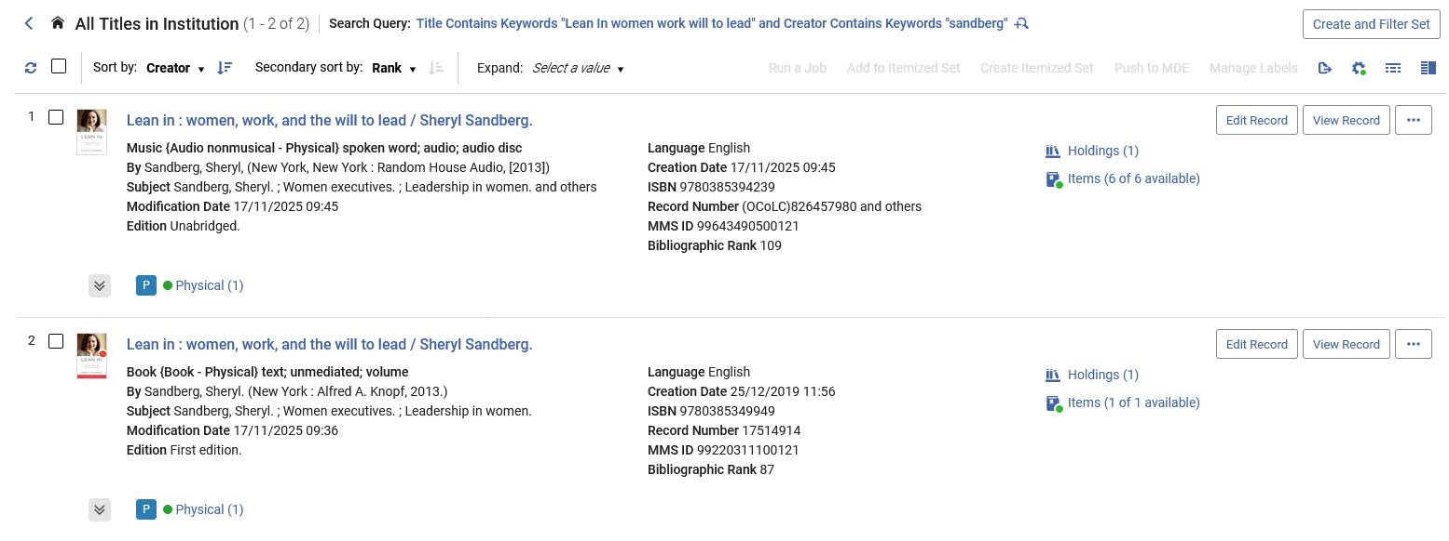
Example one: a bibliographic record to be FRBRized
Here are the records in Alma

Slide 15
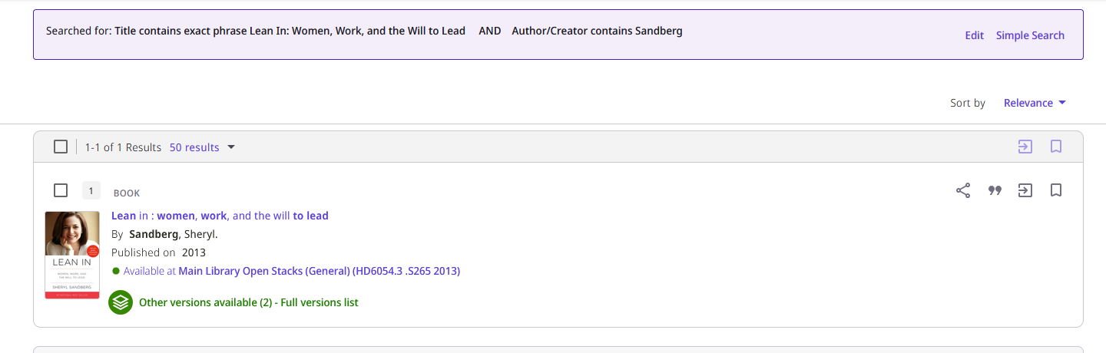
Example one: a bibliographic record to be FRBRized
Here are the records in Primo
The records have been FRBRized
We will now click “Other versions available (2) - Full versions list“

Slide 16
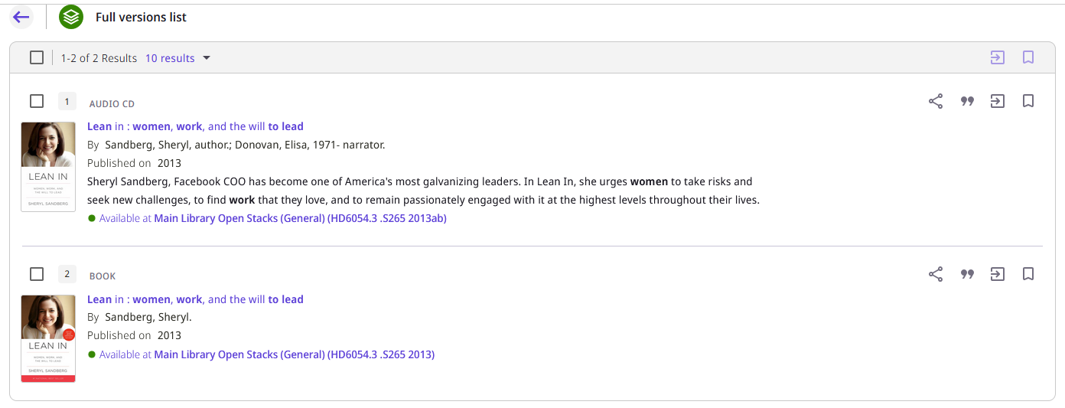
Example one: a bibliographic record to be FRBRized
After clicking “Other versions available (number) - Full versions list” both records appear.

Slide 17
Example two: a bibliographic record to be FRBRized

Slide 18
Example two: a bibliographic record to be FRBRized
Record 1
Record 2
MMS ID: 99220310700121
Title: Outrageous Acts and Everyday Rebellions
Author: Steinem, Gloria
Publisher: Jonathan Cape
Date: 1984
Format: Hardcover
ISBN: 9780224022057
Pages: 370
MMS ID : 99643490400121
Title: Outrageous Acts and Everyday Rebellions
Author: Steinem, Gloria
Publisher: H. Holt
Date: 1995
Format: Paperback
ISBN: 9780805042023
Pages: 406
Notes: 2nd ed. with a new preface and notes by the author.

Slide 19
Example two: a bibliographic record to be FRBRized
Why these should be FRBRized:
These records represent different manifestations of the same work, which is exactly what FRBR (Functional Requirements for Bibliographic Records) was designed to handle.
FRBR hierarchy for these records:
  Work level: The intellectual content – Gloria Steinem's collection of essays about feminism and social justice
  Expression level: The 1984 edition vs. the 1995 expanded edition (different intellectual content, since the second includes new material)
  Manifestation level: The physical formats - hardcover 1984 publication vs. paperback 1995 publication
  Item level: Individual copies held by libraries

Slide 20
Example two: a bibliographic record to be FRBRized
Benefits of FRBRization
  Improved user searching: A patron searching for this title would see both editions grouped together, allowing them to choose the version that best suits their needs
  Clearer relationships: Users can understand that the 1995 edition is expanded, not just a reprint
  Reduced redundancy: Shared information (author, basic title) doesn't need to be duplicated
  Better collection management: Libraries can see all versions they hold of this work at a glance

Slide 21
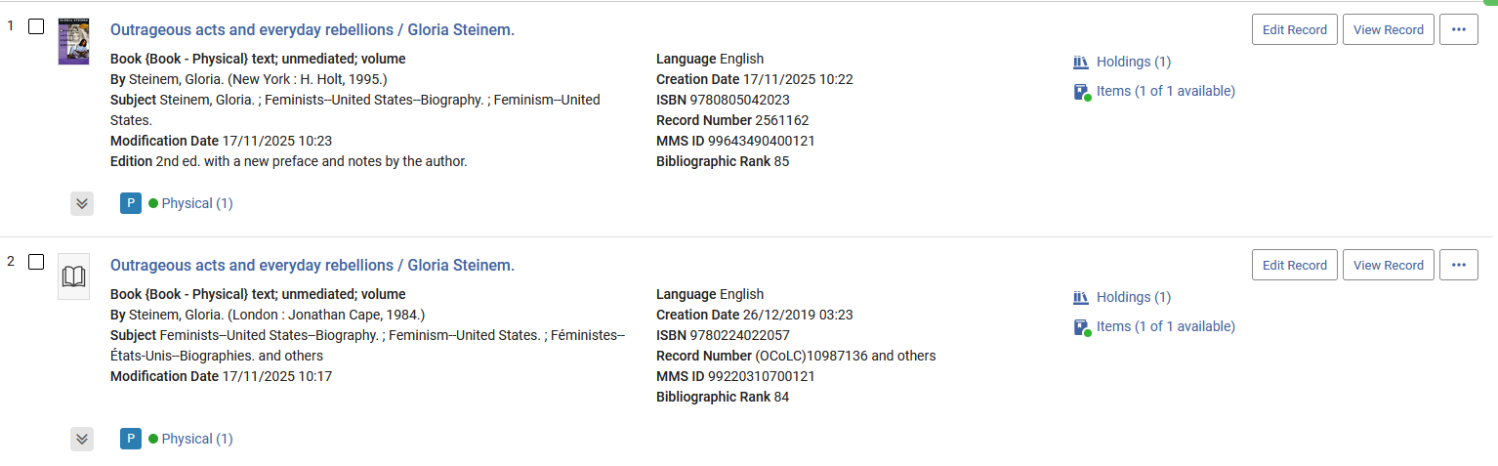
Example two: a bibliographic record to be FRBRized
Here are the records in Alma

Slide 22
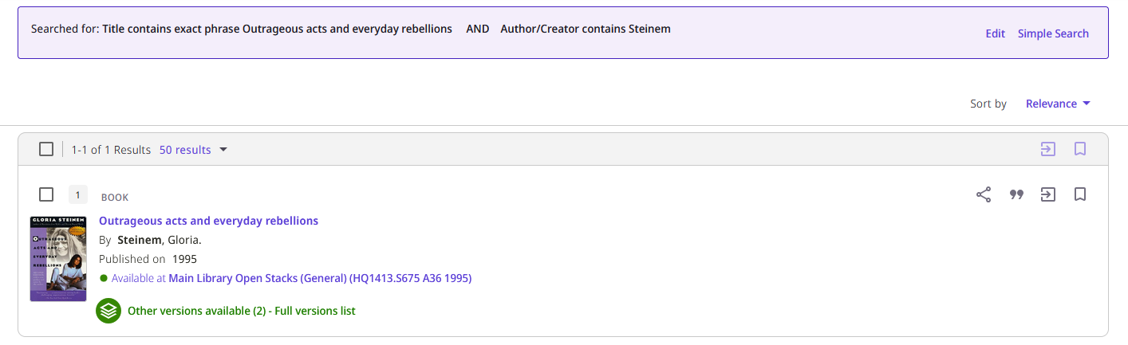
Example two: a bibliographic record to be FRBRized
Here are the records in Primo
The records have been FRBRized
We will now click ““Other versions available (2) - Full versions list” “

Slide 23
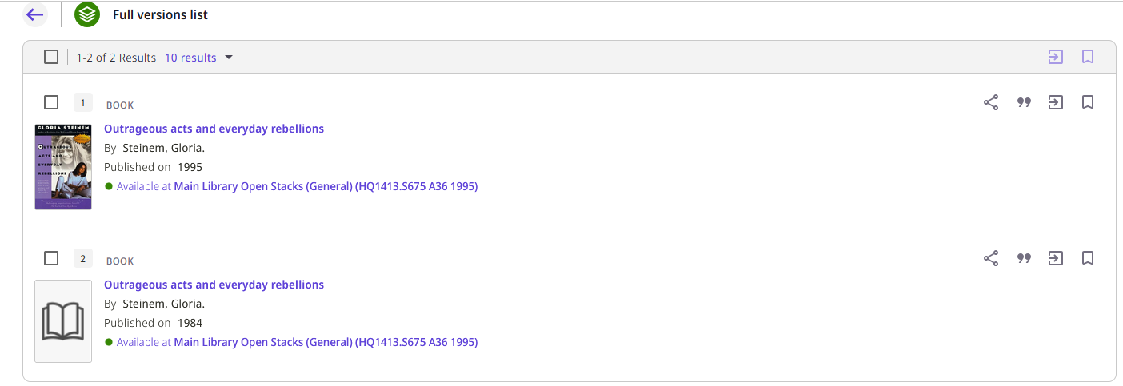
Example two: a bibliographic record to be FRBRized
After clicking “Other versions available (number) - Full versions list” both records appear.

Slide 24
Example three: a bibliographic record to be deduped

Slide 25
Example three: a bibliographic record to be deduped
Record 1
Record 2
MMS ID: 99254111000121
Title: City women : contemporary Taiwan women writers
All fields are exactly the same (except of course for the 001 and 005)
MMS ID : 99644190400121
Title: City women : contemporary Taiwan women writers
All fields are exactly the same (except of course for the 001 and 005)

Slide 26
Example three: a bibliographic record to be deduped
Why these should be Deduped:
The records are identical
Each has a holdings record and inventory in different libraries, but the bibliographic records are identical

Slide 27
Example three: a bibliographic record to be deduped
Benefits of dedup
  Improved user searching: A patron searching for this title would see both identical records grouped together as one, showing inventory of each.

Slide 28
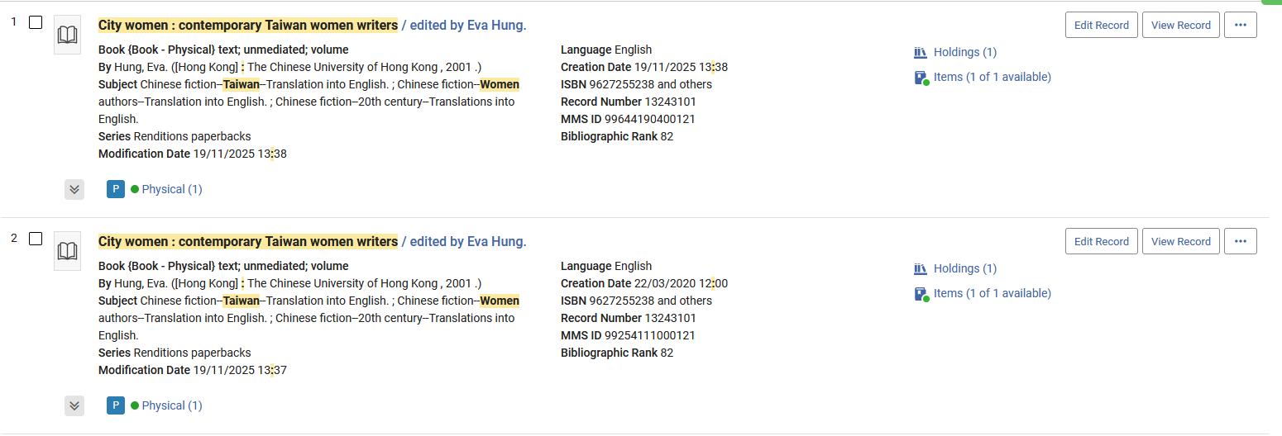
Example three: a bibliographic record to be deduped
Here are the records in Alma

Slide 29
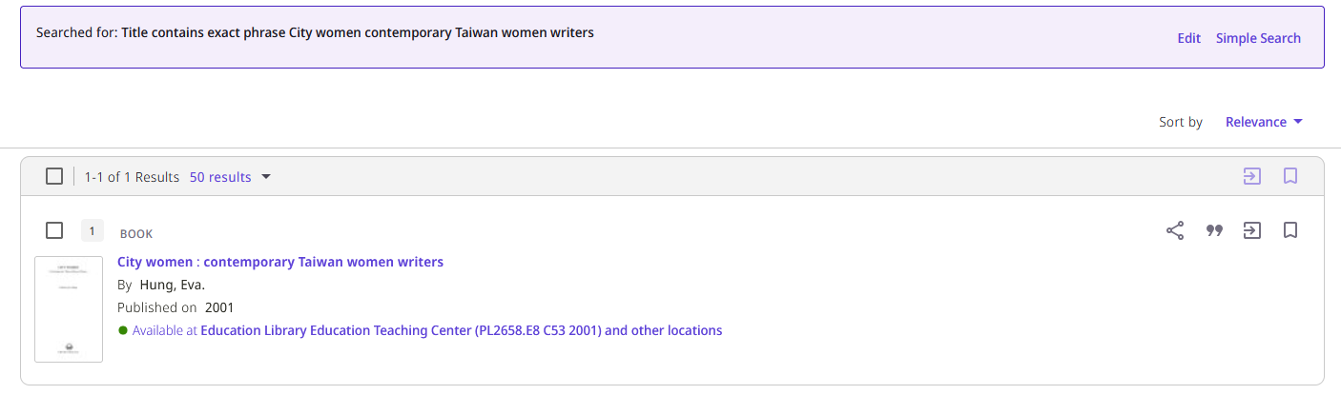
Example three: a bibliographic record to be deduped
Here are the records in Primo
The records have been deduplicated
Unlike the FRBRized records, it does not state:
“Other versions available (number) - Full versions list”.
There are not other “versions”. There are identical other records.

Slide 30

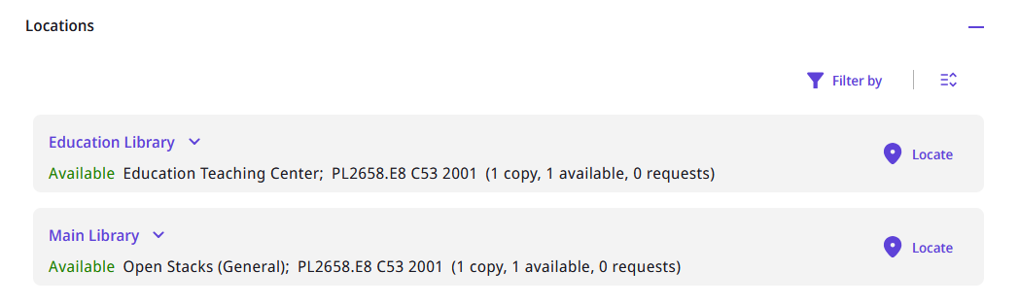
Example three: a bibliographic record to be deduped
After selecting the one deduped entry in Primo the holdings of both records appear.

Slide 31
The Mapping of the Dedup Key Fields

Slide 32
The Mapping of the Dedup Key Fields
The Mapping of the Dedup Key Fields is done according to the table at Mapping Dedup Key Fields (this can also be customized, more on that later).
The default table for these keys is in the online help at Mapping Dedup Key Fields .
Each of these keys gets combined into a “Complete Key” used for deduping and FRBRizing.
The “Complete Key” combinations can be viewed (and customized) at “Configuration > Discovery > Other > Dedup/FRBR Complete Key Combination”
The table shows, for MARC21, UNIMARC, and DC data formats, how the fields from each source record are mapped and stored in Primo VE for Dedup keys.
Let’s look at some examples (on next slides).

Slide 33

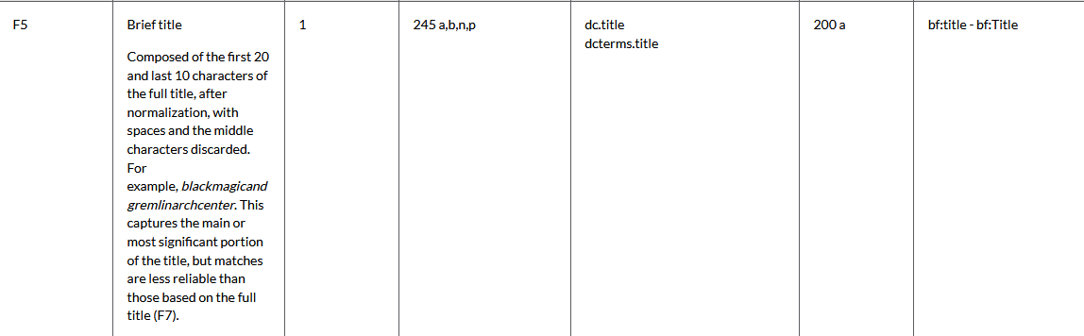
The Mapping of the Dedup Key Fields
F5 is “Brief title” for type 1
For MARC21 bibliographic records the Dedup Key F5 includes the Brief title from the 245 a,b,n,p for Dedup Key Field type 1

Slide 34
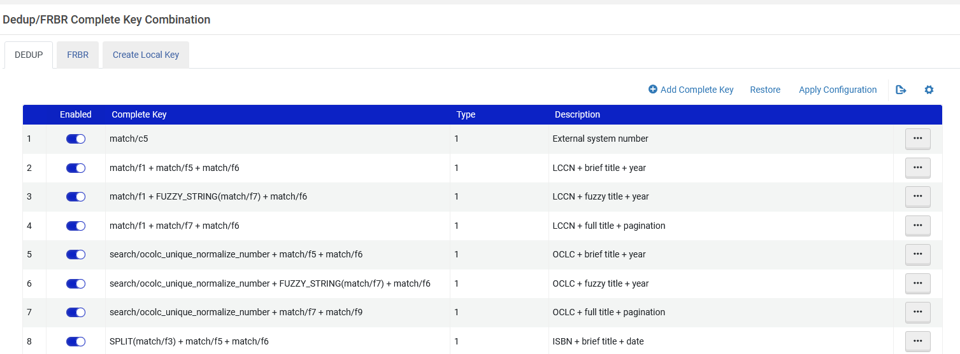
The Mapping of the Dedup Key Fields
At “Configuration > Discovery > Other > Dedup/FRBR Complete Key Combination” we can see that the F5 is “Brief Title” for type 1 for dedup
Here we see that F5 is part of several “Complete Keys”

Slide 35
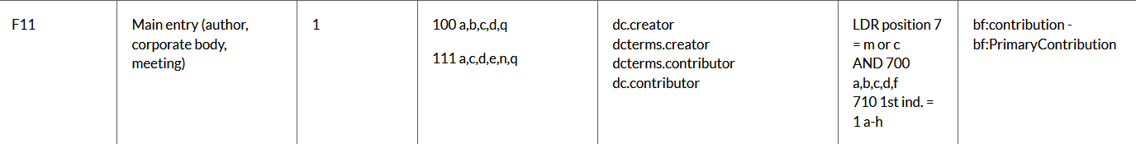
The Mapping of the Dedup Key Fields
F11 is “Main entry” for type 1
For MARC21 bibliographic records the Dedup Key F11 includes the Main entry from the 100 a,b,c,d,q or the 111a,c,d,e,n,q for Dedup Key Field type 1

Slide 36
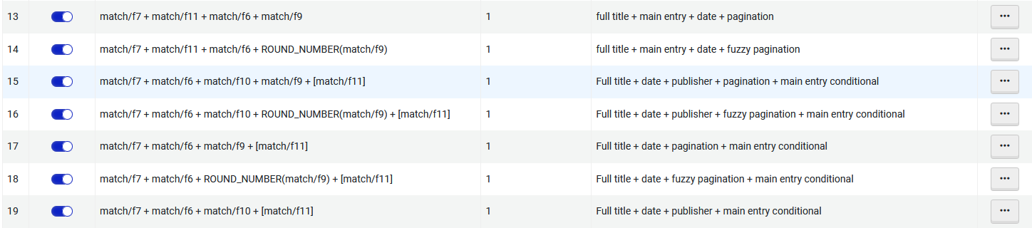
The Mapping of the Dedup Key Fields
At “Configuration > Discovery > Other > Dedup/FRBR Complete Key Combination” we can see that the F11 is “Main Entry” for type 1 for Dedup
The DEDUP tab has been chosen (but not visible in screen shot)
Here we see that F11 is part of several “Complete Keys”

Slide 37
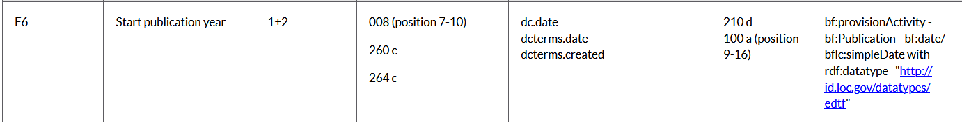
The Mapping of the Dedup Key Fields
F6 is “Start publication year” for type 1 and 2
For MARC21 bibliographic records the Dedup Key F6 includes the Start publication year from the 008 (pos. 7-10) or 260c or 264c for Dedup Key Field type 1+2

Slide 38
The Mapping of the Dedup Key Fields
At “Configuration > Discovery > Other > Dedup/FRBR Complete Key Combination” we can see that the F6 is “Start publication year” for type 1 and 2 for dedup
Here we see that F6 is part of several “Complete Keys”

Slide 39
The Mapping of the Dedup Key Fields
F10 is “Publisher” for type 1
For MARC21 bibliographic records the Dedup Key F10 includes Publisher from the 260b or 264 b for Dedup Key Field type 1

Slide 40
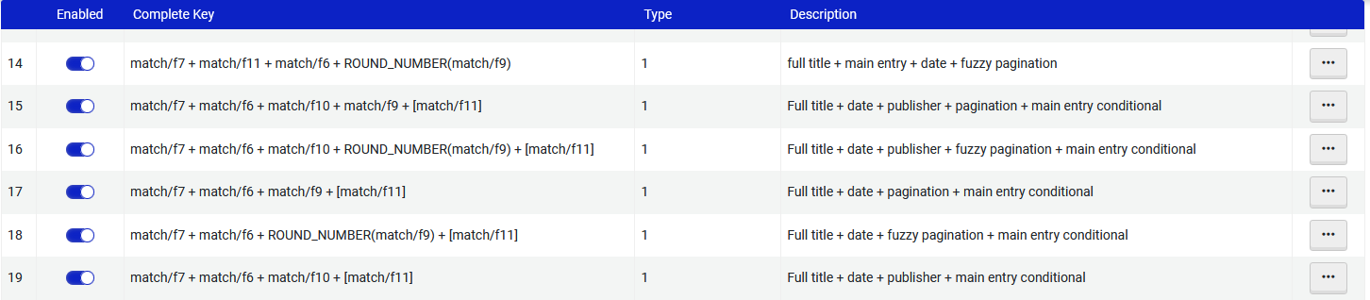
The Mapping of the Dedup Key Fields
At “Configuration > Discovery > Other > Dedup/FRBR Complete Key Combination” we can see that the F10 is “Publisher” for type 1 for dedup
The DEDUP tab has been chosen (but not visible in screen shot)
Here we see that F10 is part of several “Complete Keys”

Slide 41
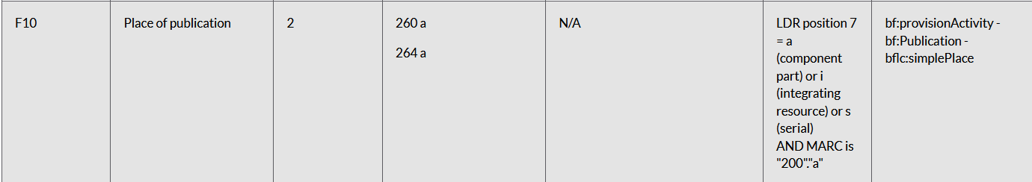
The Mapping of the Dedup Key Fields
F10 is “Place of publication” for type 2”
For MARC21 bibliographic records the Dedup Key F10 includes Place of publication from the 260a or 264 a for Dedup Key Field type 2

Slide 42
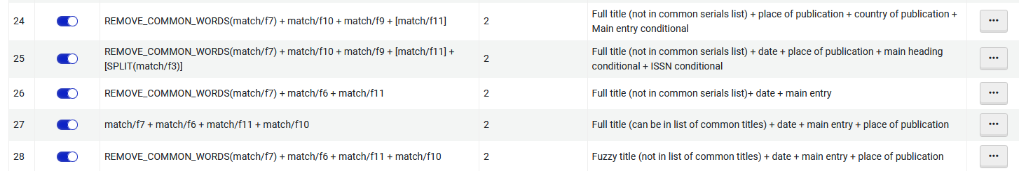
The Mapping of the Dedup Key Fields
At “Configuration > Discovery > Other > Dedup/FRBR Complete Key Combination” we can see that the F10 is “Place of publication” for type 2 for dedup
The DEDUP tab has been chosen (but not visible in screen shot)
Here we see that F10 is part of several “Complete Keys”

Slide 43
The Mapping of the FRBR Key Fields

Slide 44
The Mapping of the FRBR Key Fields
The Mapping of the FRBR Key Fields is done according to the table at Mapping FRBR Key Fields (this can also be customized, more on that later)
The table shows, for MARC21, UNIMARC, and DC data formats, how the fields from each source record are mapped and stored in Primo VE for FRBR keys.
Let’s look at some examples

Slide 45

The Mapping of the FRBR Key Fields
K3 is “Title”
For MARC21 bibliographic records the FRBR Field ID K3 includes the Title from the 245 a, b, e, f, g, n, p, and up to one of the additional fields listed based on priority,

Slide 46
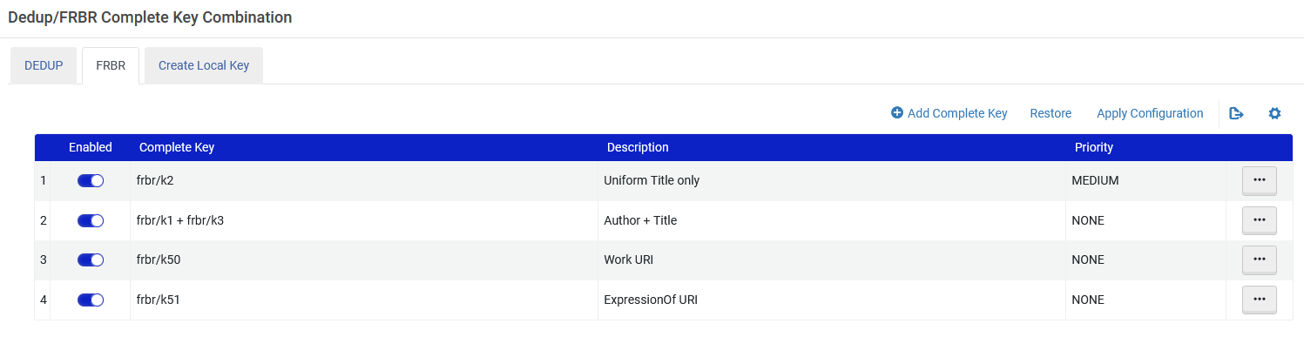
The Mapping of the FRBR Key Fields
At “Configuration > Discovery > Other > Dedup/FRBR Complete Key Combination” we can see that the K3 is “Title” for FRBR
Here we see that K3 is part of a “Complete Key” with K1 “Author”

Slide 47

The Mapping of the FRBR Key Fields
K1 is “Author”
For MARC21 bibliographic records the FRBR Field ID K1 includes the Author from the 100 a,b,c,q or the 110 a,b,c,q or the 111a,b,c,n,q

Slide 48
The Mapping of the FRBR Key Fields
At “Configuration > Discovery > Other > Dedup/FRBR Complete Key Combination” we can see that the K1 is “Author” for FRBR
Here we see that K1 is part of a “Complete Key” with K3 “Title”

Slide 49
Why was example one FRBRized

Slide 50
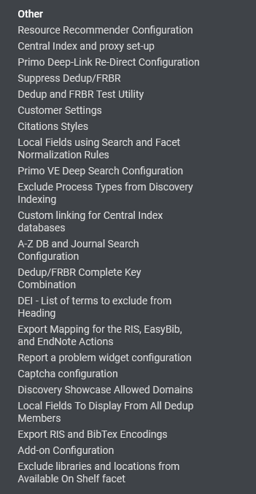
Why was example one FRBRized
Note that it is also possible to test the setup and see if and why records get Deduped or FRBRized.
This can be done at “Configuration > Discovery > Other > Dedup and FRBR Test Utility”
See also Dedup and FRBR Analysis Tool for Primo VE.
We will now access the Dedup and FRBR Test Utility

Slide 51
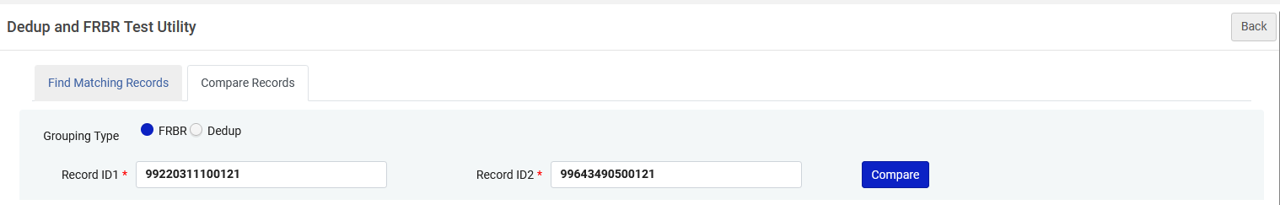
Why was example one FRBRized
Let’s see why the two records with title “Lean In: Women, Work, and the Will to Lead “ (which we previously saw in example one) were FRBRized.
The two records are MMS IDs: 99220311100121 and 99643490500121
Let’s compare the two records for FRBR using the test utility

Slide 52
Why was example one FRBRized
We can see that the records are FRBRized based on a combination of the author and title which is text “sandberg sheryl~lean in women work and the will to lead”.
This text is then converted to numerical value 9595160652259922
The text is converted to a numerical value because it is “easier” and “better” for a computer to find matches and groups via a numerical value than text.

Slide 53
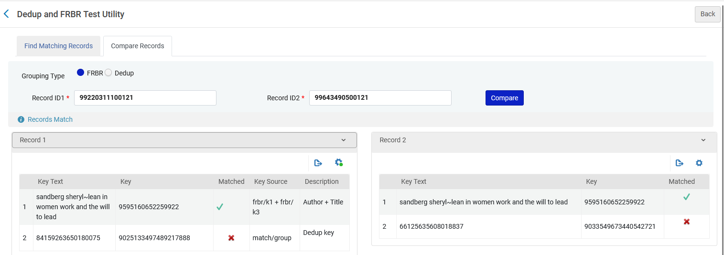
Why was example one FRBRized
Here we can see the match for FRBR is by Key Source frbr/k1 + frbr/k3
Match for FRBR is by Key Source frbr/k1 + frbr/k3
Same key

Slide 54
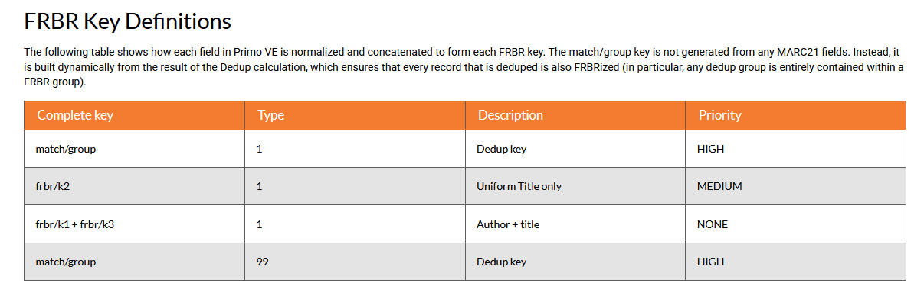
Why was example one FRBRized
At FRBR Key Definitions we can see why the match for FRBR is by Key Source frbr/k1 + frbr/k3

Slide 55
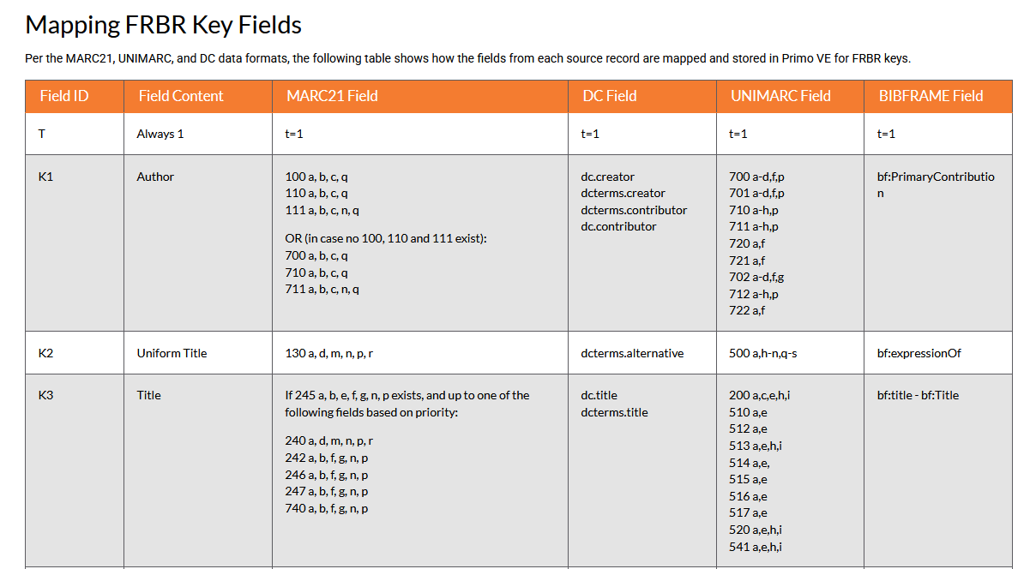
Why was example one FRBRized
Here is how the K1 and K3 keys were calculated (see also Mapping FRBR Key Fields):

Slide 56
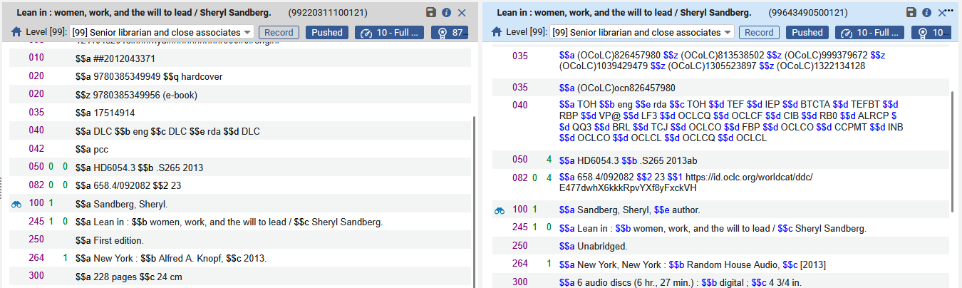
Why was example one FRBRized
In sum: the two records in this example were FRBRized because they have matching K1 and K3 fields, which are the author and the title.
The edition, publication information and physical description differ, but author and title match

Slide 57
Why was example two FRBRized

Slide 58
Why was example two FRBRized
Note that it is also possible to test the setup and see if and why records get Deduped or FRBRized.
This can be done at “Configuration > Discovery > Other > Dedup and FRBR Test Utility”
See also Dedup and FRBR Analysis Tool for Primo VE.
We will now access the Dedup and FRBR Test Utility

Slide 59
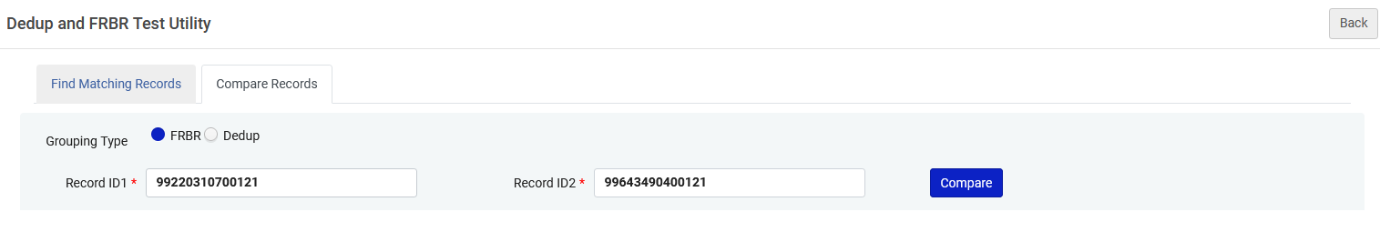
Why was example two FRBRized
Let’s see why the two records with title “Outrageous Acts and Everyday Rebellions“ (which we previously saw in example two) were FRBRized.
The two records are MMS IDs: 99220310700121 and 99643490400121
Let’s compare the two records for FRBR using the test utility

Slide 60
Why was example two FRBRized
We can see that the records are FRBRized based on a combination of the author and title which is text “steinem gloria~outrageous acts and everyday rebellions”.
This text is then converted to numerical value 62237703018636503
The text is converted to a numerical value because it is “easier” and “better” for a computer to find matches and groups via a numerical value than text.

Slide 61
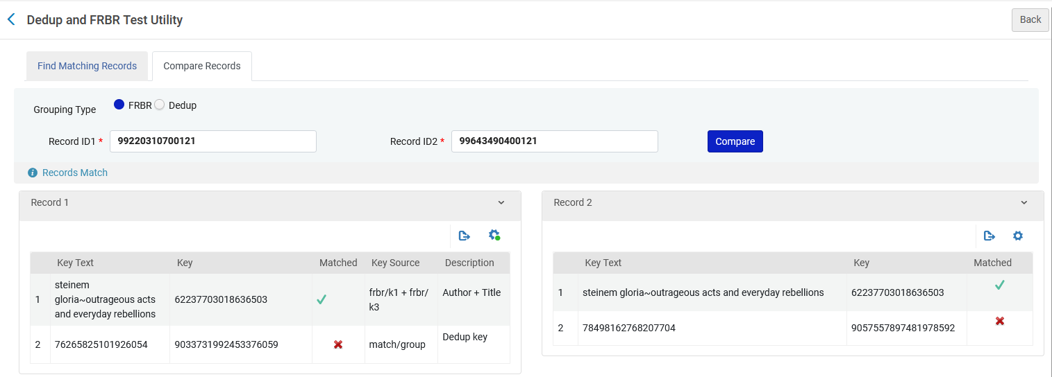
Why was example two FRBRized
Here we can see the match for FRBR is by Key Source frbr/k1 + frbr/k3
Match for FRBR is by Key Source frbr/k1 + frbr/k3
Same key

Slide 62
Why was example two FRBRized
At FRBR Key Definitions we can see why the match for FRBR is by Key Source frbr/k1 + frbr/k3

Slide 63
Why was example two FRBRized
Here is how the K1 and K3 keys were calculated (see also Mapping FRBR Key Fields):

Slide 64
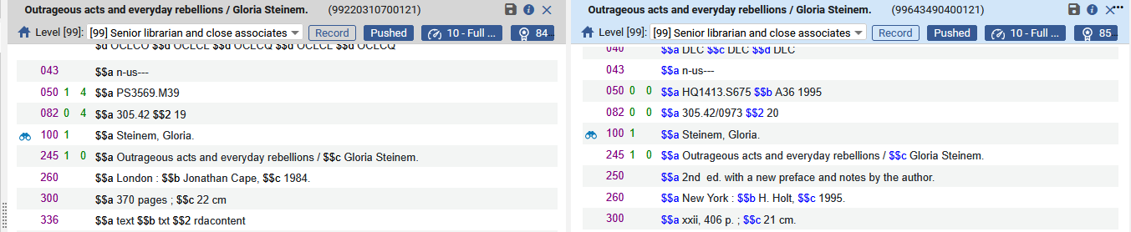
Why was example two FRBRized
In sum: the two records in this example were FRBRized because they have matching K1 and K3 fields, which are the author and the title.
The edition, publication information and physical description differ, but author and title match

Slide 65
Why was example three deduped

Slide 66
Why was example three deduped
Note that it is also possible to test the setup and see if and why records get Deduped or FRBRized.
This can be done at “Configuration > Discovery > Other > Dedup and FRBR Test Utility”
See also Dedup and FRBR Analysis Tool for Primo VE.
We will now access the Dedup and FRBR Test Utility

Slide 67
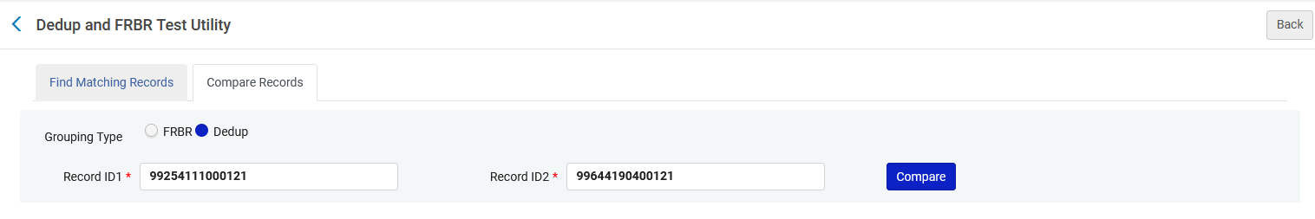
Why was example three deduped
Let’s see why the two records with title “City women : contemporary Taiwan women writers“ (which we previously saw in example three) were FRBRized.
The two records are MMS IDs: 99644190400121 and 99254111000121
Let’s compare the two records for Dedup using the test utility

Slide 68
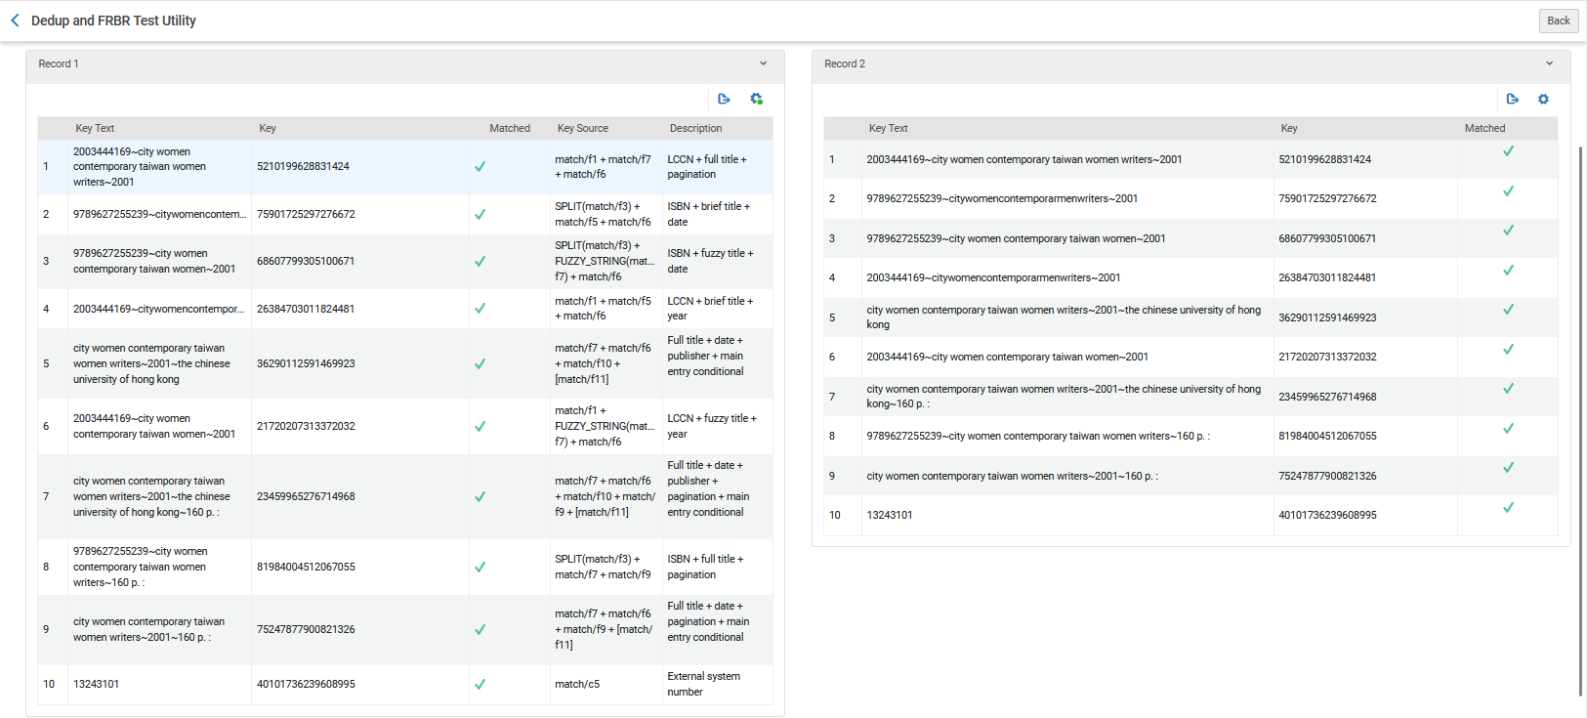
Why was example three deduped
We see that every possible key text is a match. Each entire record is a match on the other record, and therefore they are considered duplicates

Slide 69
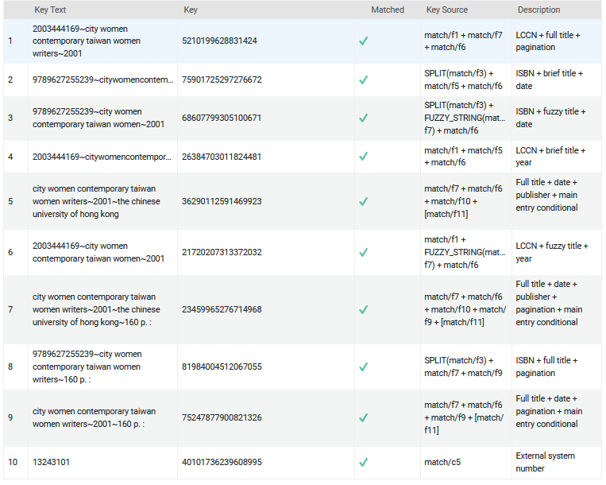
Why was example three deduped
All of these key combinations in the two records match each other
As an example, let’s look at
SPLIT(match/f3) + match/f5 + match/f6 ISBN + brief title + date

Slide 70
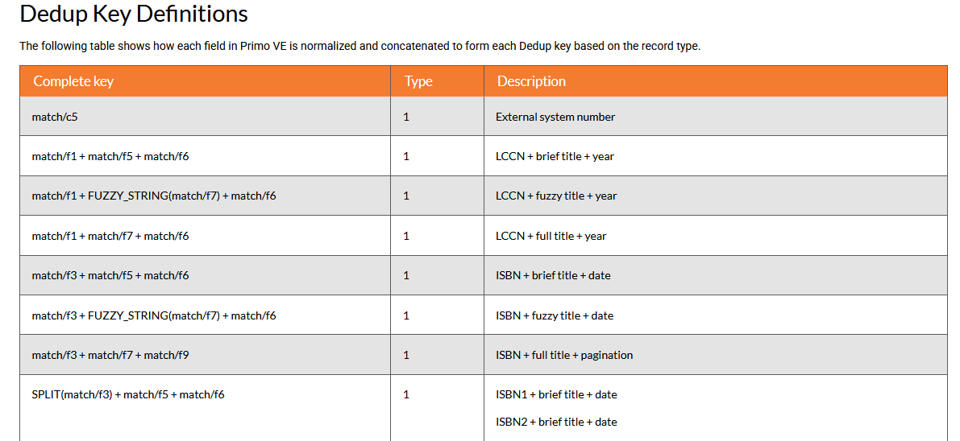
Why was example three deduped
At Dedup Key Definitions we can see why the match for the dedup is by Key Source SPLIT(match/f3) + match/f5 + match/f6 ISBN + brief title + date

Slide 71
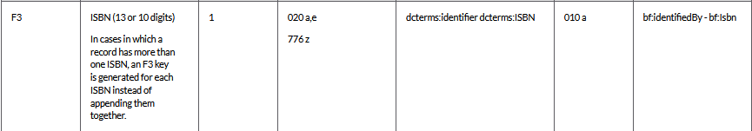
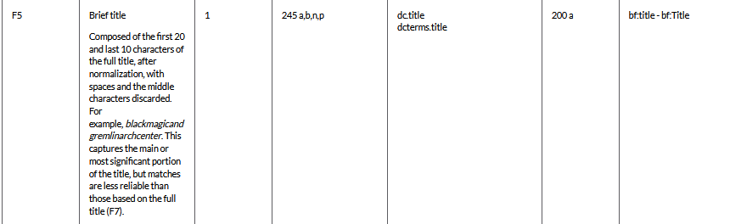
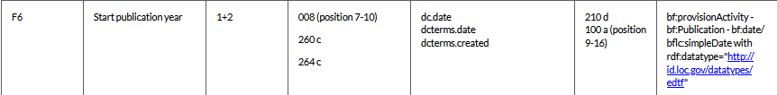
Why was example three deduped
Here is how the F3, F5 and F6 keys were calculated (see also Mapping Dedup Key Fields) for SPLIT(match/f3) + match/f5 + match/f6 ISBN + brief title + date

Slide 72
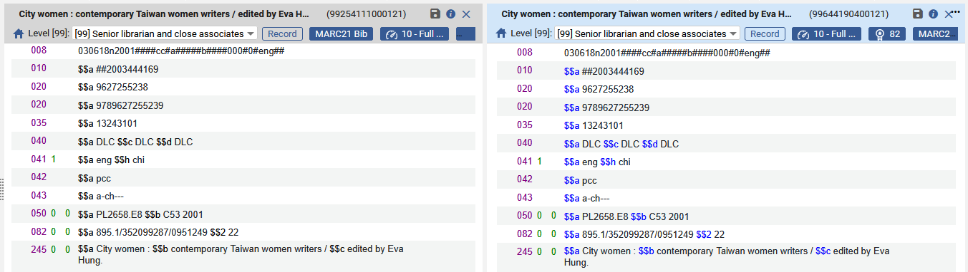
Why was example three deduped
In sum: the two records in this example were deduped, in part, because they have matching K1 and K3 fields, which are the author and the title (we state “in part” because other parts of the record also have matches thereby making them duplicates).

Slide 73
Disabling the Dedup and FRBRization entirely

Slide 74
Disabling the Dedup and FRBRization entirely
Question from the webinar chat:
This is now very clear, and we understand how the Dedup and FRBR work. Thank you for taking the time to explain it. However, in any case, we do not want any of our records to go through the Dedup or FRBR processes because we want each record to appear on its own in Primo search results. Can we turn this off for the entire institution?
Brief answer before showing it live:
If you want to prevent the display of FRBR and Dedup groups for all records without changing any rules or running any jobs, you can disable FRBR/Dedup by configuring the Enable Dedup and Enable FRBR fields on the Brief Results tab on the View Configuration page (Configuration Menu > Discovery > Display Configuration > Configure Views). For more information, see Brief Results Tab.

Slide 75
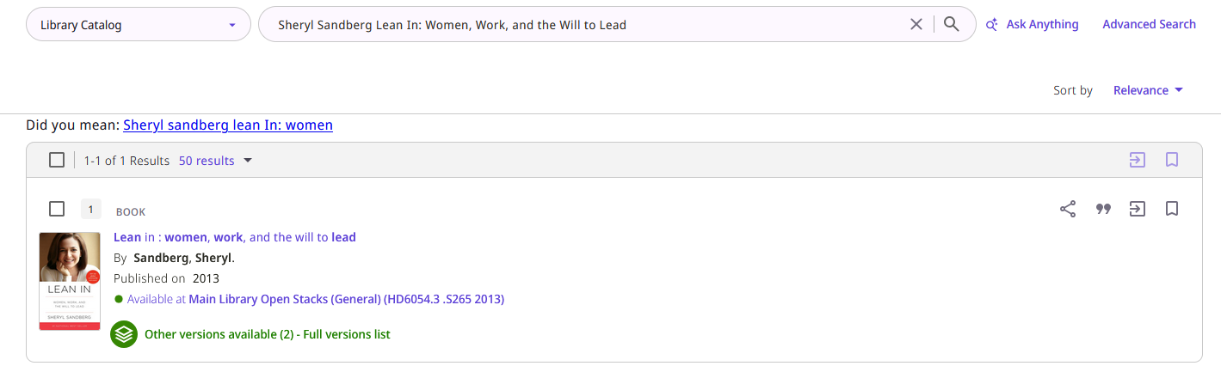
Disabling the Dedup and FRBRization entirely
Currently if we search Primo for “Sheryl Sandberg Lean In: Women, Work, and the Will to Lead” we get two records FRBRized into one:
Before disabling the FRBR

Slide 76
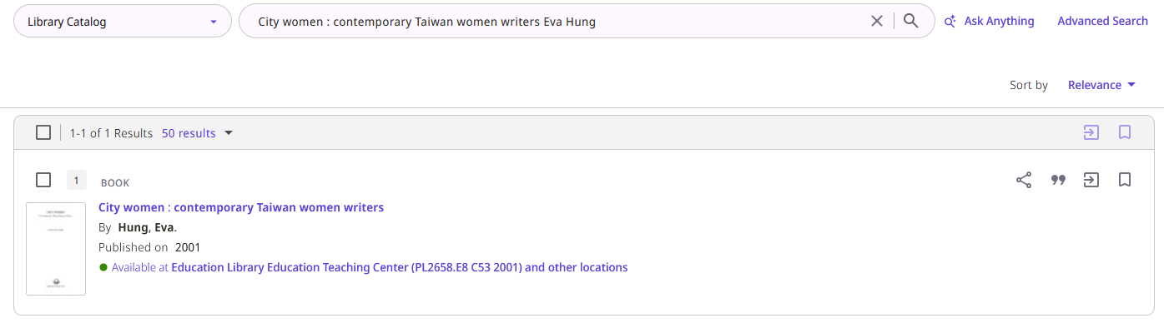
Disabling the Dedup and FRBRization entirely
Currently if we search Primo for “City women : contemporary Taiwan women writers Eva Hung” we get two records deduped into one:
Before disabling the Dedup

Slide 77
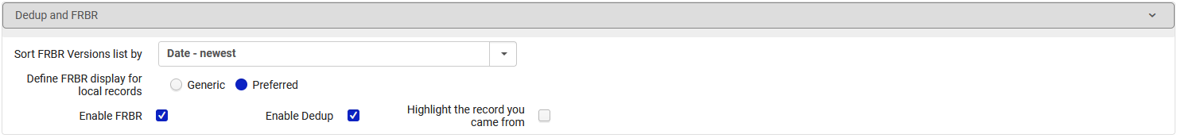
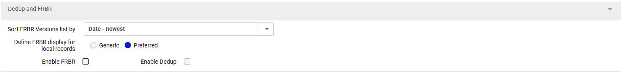
Disabling the Dedup and FRBRization entirely
The institution can disable entirely both the Dedup or FRBR in the configuration of the Primo view.
Edit the Primo view at “Configuration > Discovery > Display Configure > Configure Views”.
Scroll to the section “Dedup and FRBR” and uncheck Enable Dedup and Enable FRBR
Configuration before
Configuration after

Slide 78
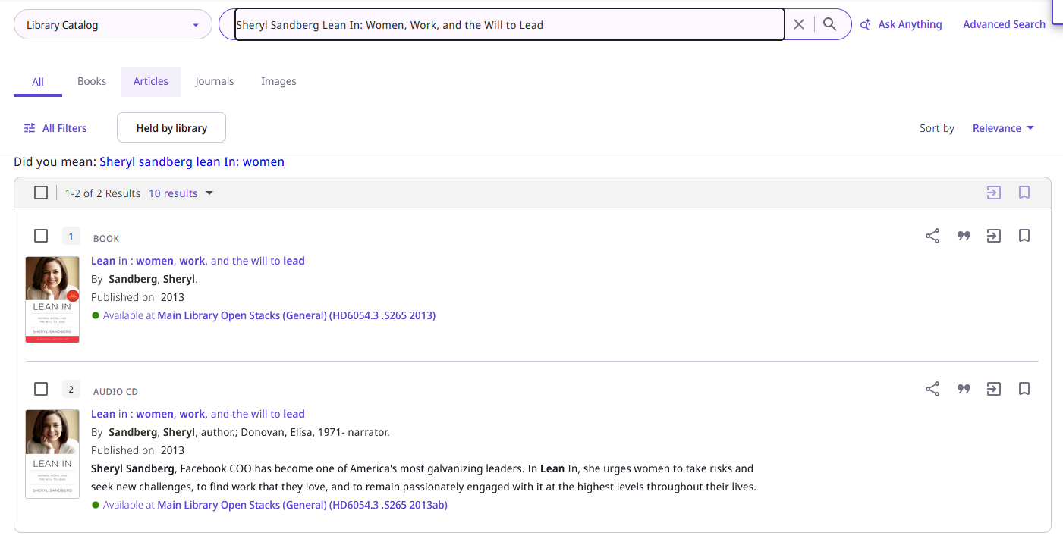
Disabling the Dedup and FRBRization entirely
Now, after disabling the FRBR entirely, if we search Primo for “Sheryl Sandberg Lean In: Women, Work, and the Will to Lead” we get two records. We do not get one FRBRized record:
After disabling the FRBR

Slide 79
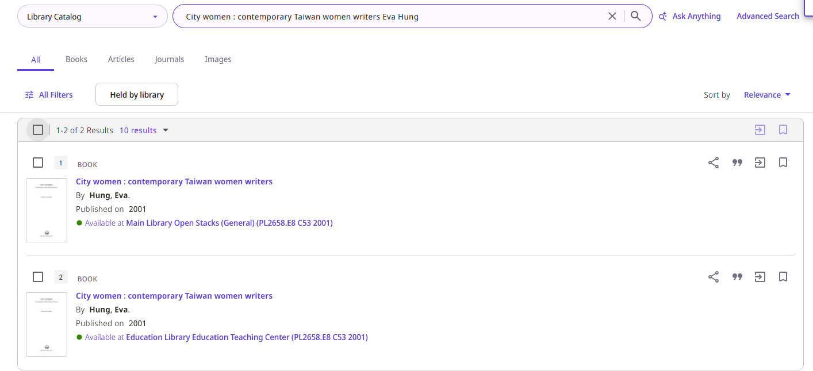
Disabling the Dedup and FRBRization entirely
Now, after disabling the Dedup entirely, if we search Primo for “City women : contemporary Taiwan women writers Eva Hung” we get two records. We do not get one Deduped record:
After disabling the Dedup

Slide 80
Disabling the Dedup and FRBRization for specific records

Slide 81
Disabling the Dedup and FRBRization for specific records
Question from the webinar chat:
In one of your YouTube videos, I saw how you turned off the dedup and FRBR for a whole Primo View. I tried it and it works. But how can I turn it off only for specific records?.
Brief answer before showing it live:
There are two options to do this:
Make a set of records which you do not want to be FRBRized or Deduped and on the set run the job “Prevent FRBR and/or Dedup in Discovery”
Make a Dedup / FRBR suppression rule at Configuration > Discovery > Other > Suppress Dedup/FRBR .
For more information, see Suppressing Groups of Records from Dedup/FRBR for Primo VE.

Slide 82
Disabling the Dedup and FRBRization for specific records
For information about the second option:
  “Make a Dedup / FRBR suppression rule at Configuration > Discovery > Other > Suppress Dedup/FRBR“
see Define suppression rules, which are based on types of records
We will now do this option:
  “Make a set of records which you do not want to be FRBRized or Deduped and on the set run the job “Prevent FRBR and/or Dedup in Discovery”.
Before we make a set and run the job, we see the situation beforehand.

Slide 83
Disabling the Dedup and FRBRization for specific records
Currently if we search Primo for “Sheryl Sandberg Lean In: Women, Work, and the Will to Lead” we get two records FRBRized into one:
Before running the job “Prevent FRBR and/or Dedup in Discovery”
And if we click “… Full versions list” …

Slide 84
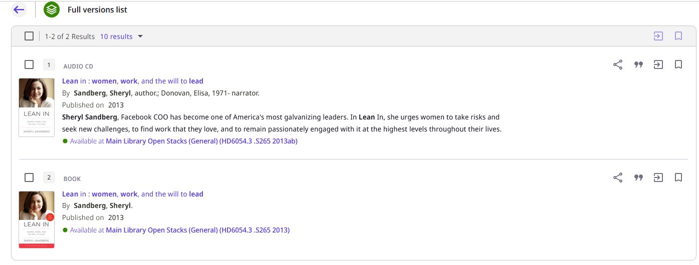
Disabling the Dedup and FRBRization for specific records
These are the two records which were FRBRized.

Slide 85
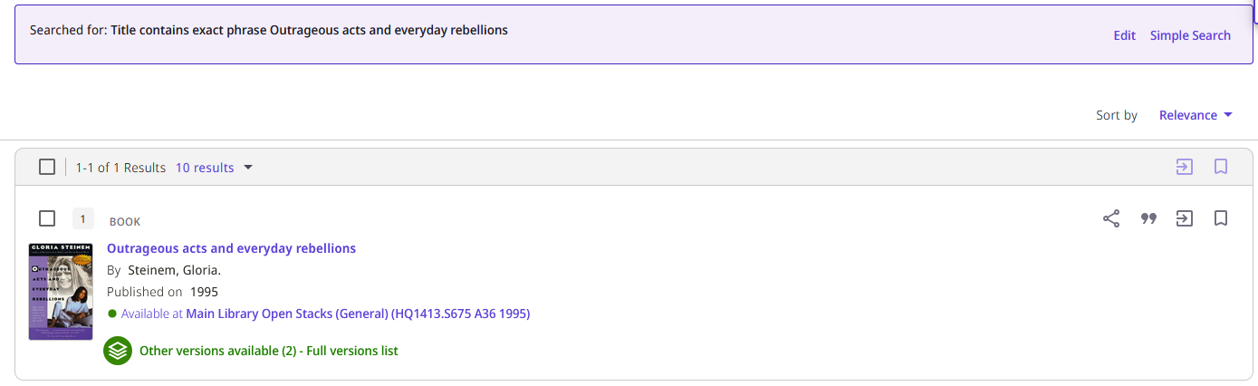
Disabling the Dedup and FRBRization for specific records
Currently if we search Primo for “Title contains exact phrase Outrageous acts and everyday rebellions” we get two records FRBRized into one:
Before running the job “Prevent FRBR and/or Dedup in Discovery”
And if we click “… Full versions list” …

Slide 86
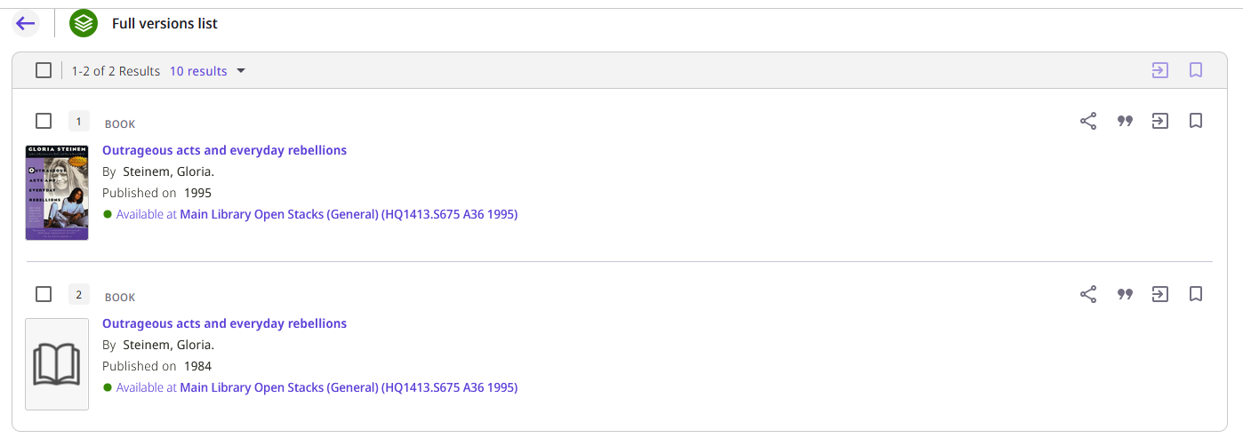
Disabling the Dedup and FRBRization for specific records
These are the two records which were FRBRized.

Slide 87
Disabling the Dedup and FRBRization for specific records
We will now make a set of the two records which are for title “Lean in : women, work, and the will to lead / Sheryl Sandberg.”
Then on that set we will run the job “Prevent FRBR and/or Dedup in Discovery” and specify in the job that we want to suppress Dedup and FRBR

Slide 88
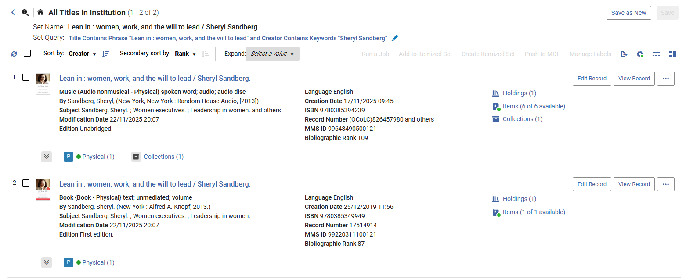
Disabling the Dedup and FRBRization for specific records
Here is the set of records which were FRBRized and have title “Lean in : women, work, and the will to lead / Sheryl Sandberg.”

Slide 89
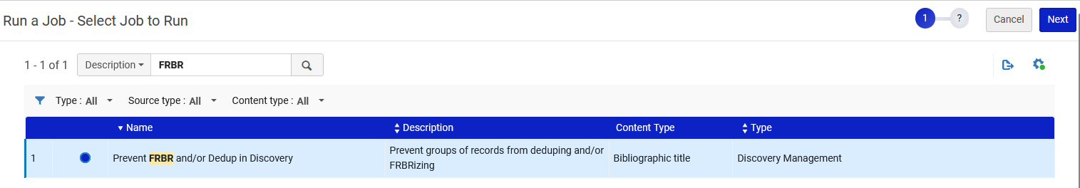
Disabling the Dedup and FRBRization for specific records
Now at “Admin > Manage Jobs and Sets > Run a Job” we will run the job “Prevent FRBR and/or Dedup in Discovery”

Slide 90
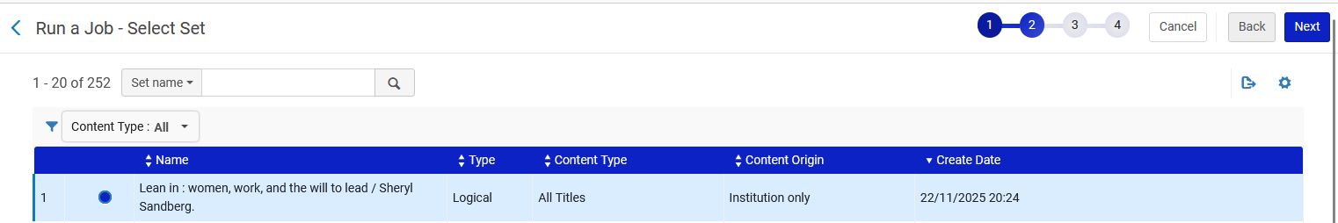
Disabling the Dedup and FRBRization for specific records
We will choose the set with the titles for “Lean in : women, work, and the will to lead / Sheryl Sandberg.”

Slide 91
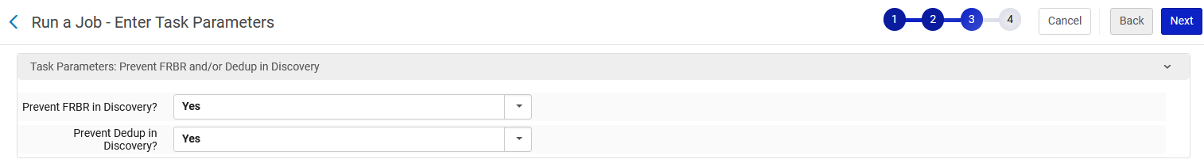
Disabling the Dedup and FRBRization for specific records
We will choose “Yes” for both options “Precent FRBR is Discovery?” and “Prevent Dedup in Discovery?”

Slide 92
Disabling the Dedup and FRBRization for specific records
The job has successfully completed.

Slide 93
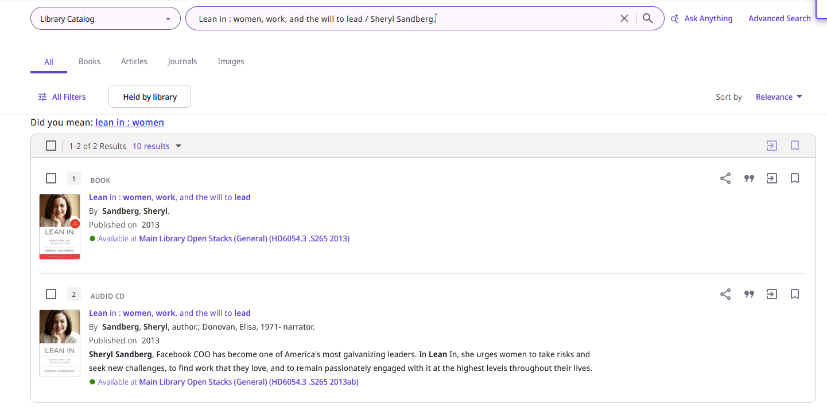
Disabling the Dedup and FRBRization for specific records
Now if we search Primo for title “Lean in : women, work, and the will to lead / Sheryl Sandberg.” it is no longer FRBRized (because the job suppressed the FRBRization for these records

Slide 94
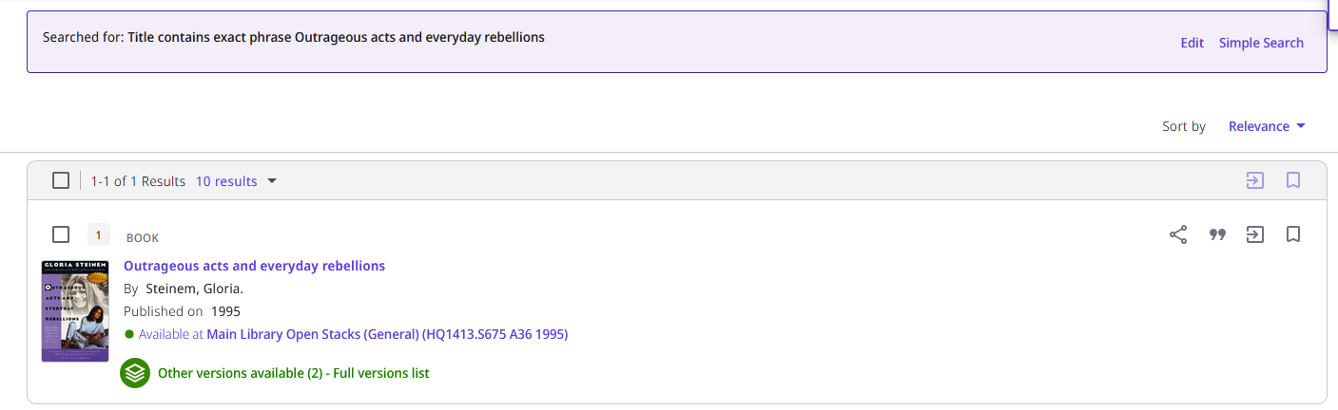
Disabling the Dedup and FRBRization for specific records
However, title “Outrageous acts and everyday rebellions / Gloria Steinem.” is still FRBRized because it was not in a set on which the job “Prevent FRBR and/or Dedup in Discovery” was run.

Slide 95

Disabling the Dedup and FRBRization for specific records
Further, if we run the “Dedup and FRBR Test Utility” on the records for title “Lean in : women, work, and the will to lead / Sheryl Sandberg.” we see that they are suppressed for FRBRization.

Slide 96

Disabling the Dedup and FRBRization for specific records
If we want to unsuppress the records from FRBRization we can again run the job “Prevent FRBR and/or Dedup in Discovery” on the same set and this time choose “No” for both options “Precent FRBR is Discovery?” and “Prevent Dedup in Discovery?”

Slide 97
Disabling the Dedup and FRBRization for specific records
The job “Prevent FRBR and/or Dedup in Discovery” has completed after we chose “No” for both options “Precent FRBR is Discovery?” and “Prevent Dedup in Discovery?”

Slide 98

Disabling the Dedup and FRBRization for specific records
Now if we run the “Dedup and FRBR Test Utility” on the records for title “Lean in : women, work, and the will to lead / Sheryl Sandberg.” we see that they are no longer suppressed for FRBRization.

Slide 99

Disabling the Dedup and FRBRization for specific records
And we see that in Primo the records are again FRBRized

Slide 100
Other configurations for Dedup and FRBR

Slide 101
Other configurations for Dedup and FRBR
Other configurations exist for Dedup and FRBR, but are beyond the scope of this presentation.
The reader is strongly encouraged to see:
  Recalculate Dedup and FRBR Groups.
  Configuring the Dedup and FRBR Complete Keys in Primo VE
  Configuring FRBR/Dedup Display Options

Slide 102

Yoel Kortick
Yoel.Kortick@clarivate.com
About Clarivate
Clarivate is a leading global provider of transformative intelligence. We offer enriched data,
insights & analytics, workflow solutions and expert services in the areas of Academia & Government, Intellectual Property and Life Sciences & Healthcare. For more information, please visit clarivate.com.
© 2026 Clarivate. All rights reserved
Clarivate and its logo, as well as all other trademarks used herein are trademarks of their respective owners and used under license.

